Slide 1
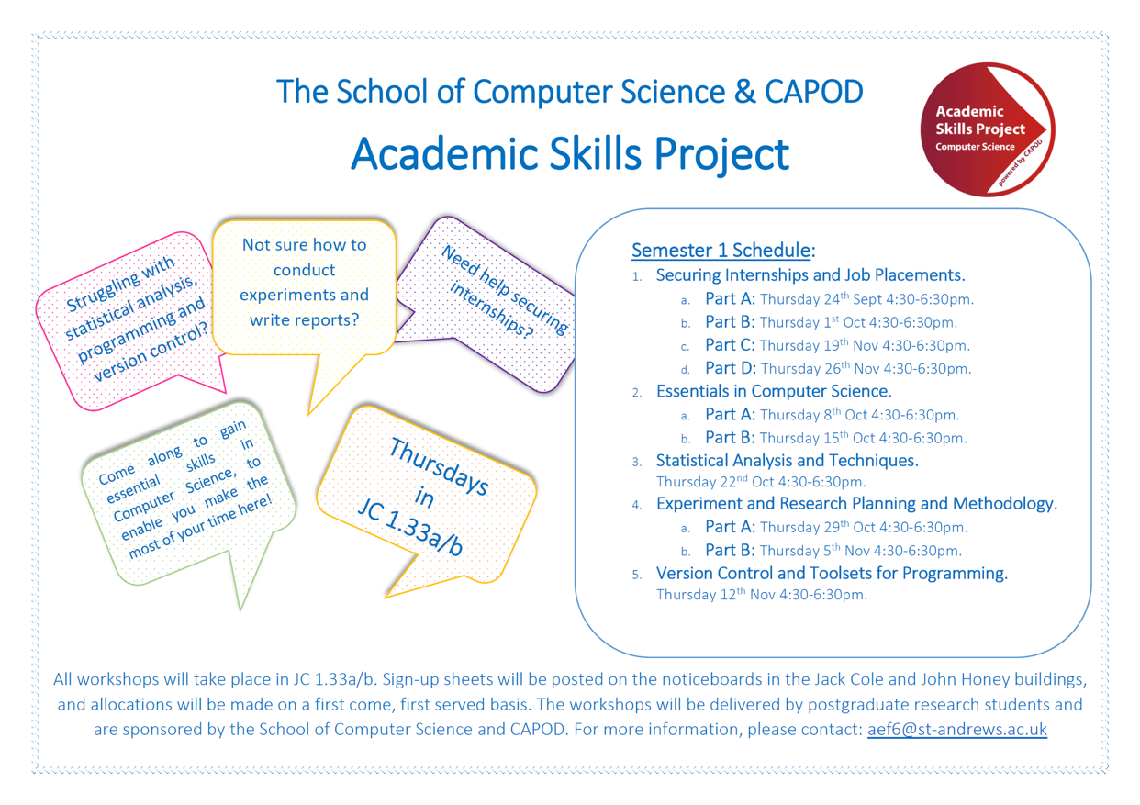

Slide 3

UKIEPC (24th October)
UK & Ireland Programming Contest
Opened to everyone (from 1st years to PhD students to staff)
This Saturday - practice sessions (check FB)

Slide 4
Tech-Fayre (23rd October)
Looking for Internships/Jobs?
Many tech companies
Where: Anges Blackhadder Hall
Networking event following

Slide 5
CodeCon (27th October)
7 Universities in the UK Competing
Registration https://bloomberg-uk-codecon.eventbrite.co.uk/

Slide 6
Essentials in CS - Part I - by Martin
Last week:
How to write a good report
How to write a report efficiently
Elements of good and bad style
Avoiding miscounduct

Slide 7
Next week - Statistical Analysis and Techniques
22nd October @ 1630-1830 Vinodh Sampath
This workshop will focus on techniques for analysing data and carrying out statistical computations using R language.
Everyone is welcome!

Slide 8
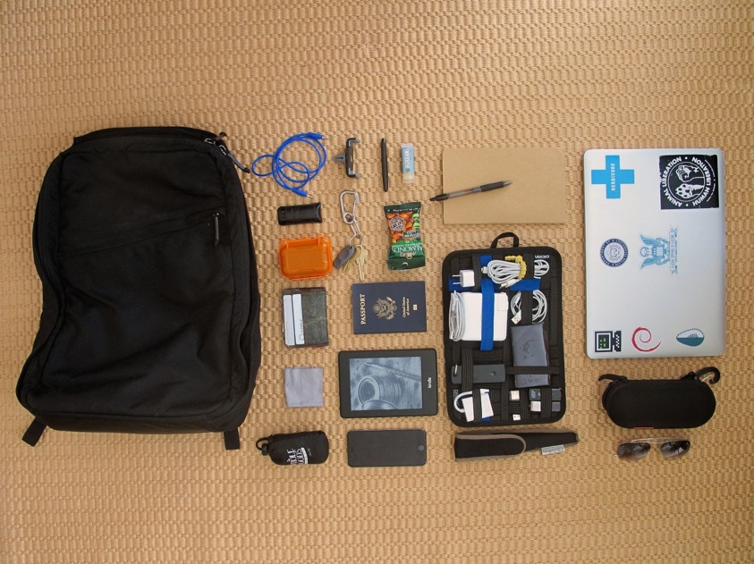
Essentials in CS - Part II
15th October 2015
@ 1630-1830
Simone I. Conte (sic2)
http://sic2.host.cs.st-andrews.ac.uk/
Thanks to:
Shyam Reyal, Graham Kirby, Steve Linton, Adrian O’Leinski, Neil Moore, Peter Brown, Mark-Jan Neederhof, Alex Voss, Martin McCaffery, Shyam Reyal, Ian Paterson, Nick Goodall, Richie McMahon, Ishbel Duncan, Jan de Muijnck-Hughes, Lee Huang, Andrew Matheson, Daniel Patterson, Chris Jefferson
all other people I have met over the years
and SO

Slide 9
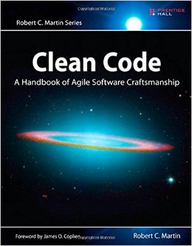
Credits
Clean Code - Available in library (x4)
@@@
CS5030/1 by Alex Voss
https://studres.cs.st-andrews.ac.uk/CS5031/
@@@
Experts’ opinions
https://sic2.host.cs.st-andrews.ac.uk/aiq.html

Slide 10

Outline
Aims
Marking scale
Becoming a better
Programmer
Computer Scientist
Good and Bad code
Reproducibility and Testing

Slide 11
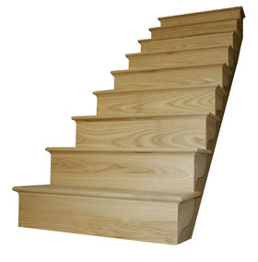
The 20 marking scale

Slide 12

The 20 marking scale

Slide 13
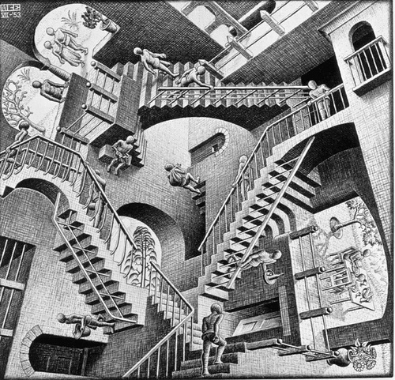
The 20 marking scale
Relativity (M. C. Escher)
1953

Slide 14
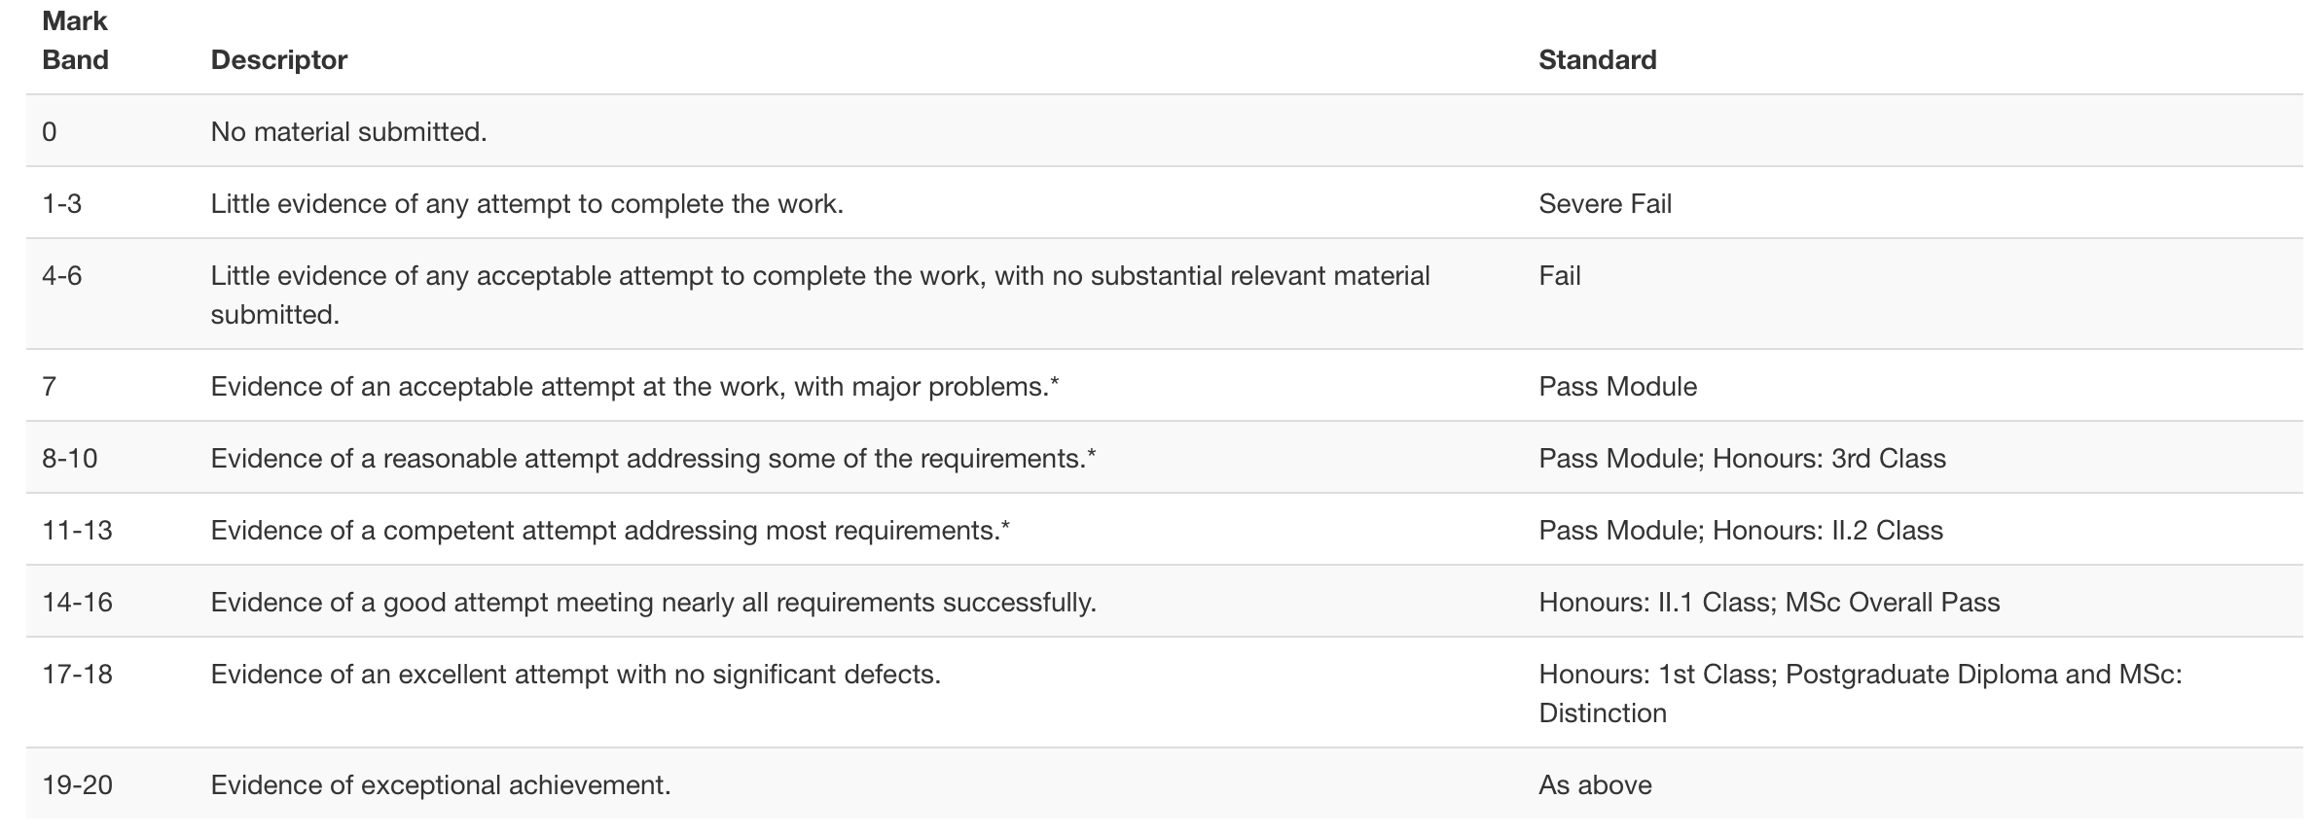
Mark Descriptors (General)

Slide 15
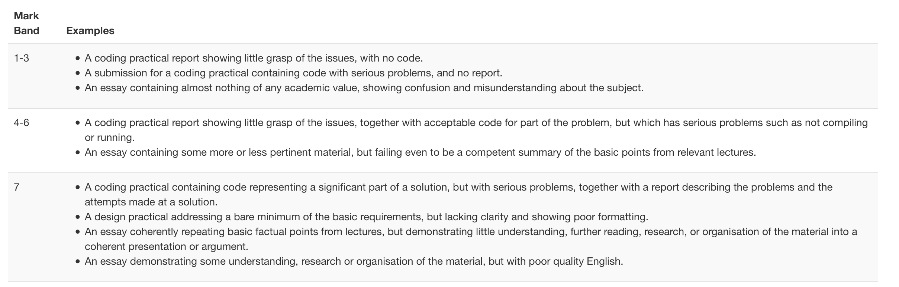
Mark Descriptors (CW I)

Slide 16
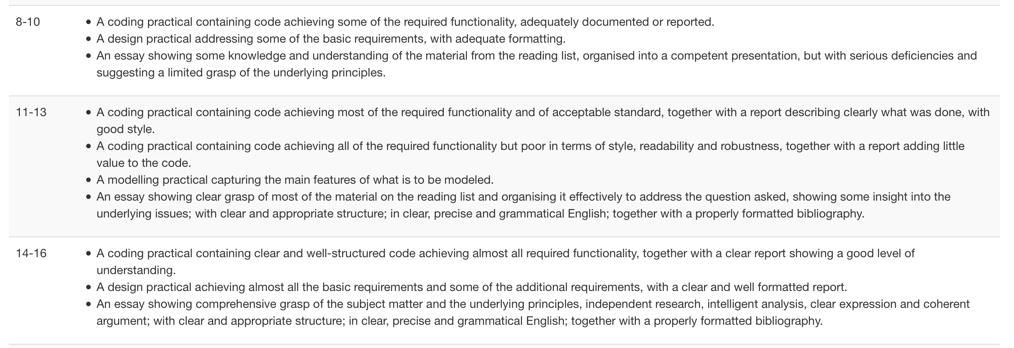
Mark Descriptors (CW II)

Slide 17
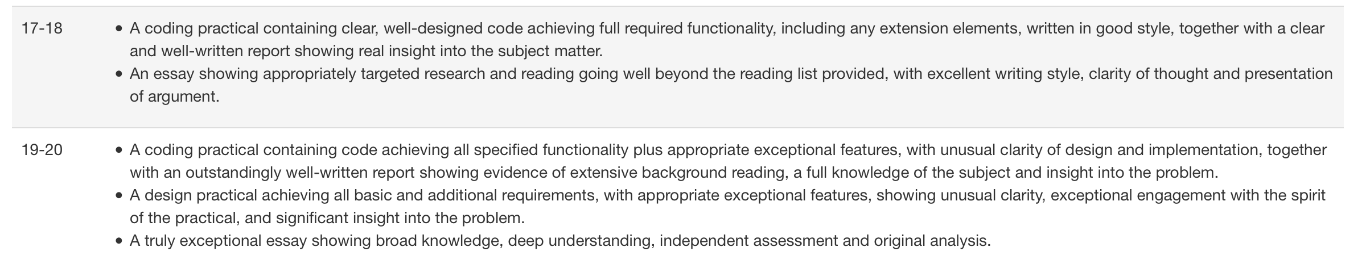
Mark Descriptors (CW III)
More here → https://info.cs.st-andrews.ac.uk/student-handbook/learning-teaching/feedback.html

Slide 18
The 20 grading scale
We do not mark down
We do not mark up
We use mark descriptors and our own judgment
This workshop is about *What we think good code looks like* and there might not be a 1:1 correspondence with the mark you will get
Work hard

Slide 19


Slide 20
Who are you?
Students
Interns
Future engineers
Future scientists
Computer scientists
Future St Andrews Graduates
Innovators
Lots more

Slide 21
Improve your coursework
Aims of workshop
Not necessarily better grades, that is up to the markers
Cannot cover everything in 2 hours (150+ slides)
Will be superficial over some bits.
Understand the basic ideas behind good code
Improve yourself, know what to expect when working for industry
Notes:
Never met a company looking for someone discrete
watermark - disclaimer

Slide 22
Some feedback - Steve Linton
“Overall, you're good at getting the program to do what you want it to,
but that isn't the point (at least in the upper grade ranges where
you should be playing). You should produce simple, clean code,
relevant comments, matching design and you should, always, always,
stick to the documented behaviour of interfaces.”

Slide 23
Some feedback - Jan de Muijnck-Hughes
“When submitting practicals, think of the poor marker who has to assess
your work. If you can make their life easier in presentation of your
work it can go a long way.”

Slide 24
Some feedback - Mark-Jan Nederhof
* Foremost, carefully read the specification of the assignment.
Creating software to match specs is an important skill in computer science.
* Complexity is not something to strive for in programming.
If you can solve a task in a simple way, it is almost always better than solving it in a complex way.

Slide 25
Why good code matters
Your marker
Yourself
You are not alone
Mantaining code
agility - ability to adapt quickly to needs
billions of lines of code (see Google, FB, etc)
Notes:
not all students know what agile means

Slide 26
Why good code matters
4 - Code is like a poem; it's not just something we write to reach some practical result. Sometimes people that are far from the Redis philosophy suggest using other code written by other authors (frequently in other languages) in order to implement something Redis currently lacks. But to us this is like if Shakespeare decided to end Enrico IV using the Paradiso from the Divina Commedia. Is using any external code a bad idea? Not at all. Like in "One Thousand and One Nights" smaller self contained stories are embedded in a bigger story, we'll be happy to use beautiful self contained libraries when needed. At the same time, when writing the Redis story we're trying to write smaller stories that will fit in to other code.
[ Antirez, Redis Manifesto ]

Slide 27
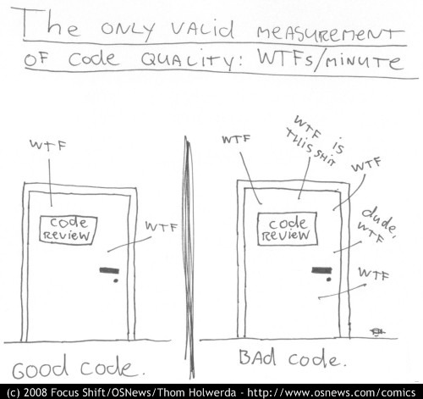
http://www.osnews.com/story/19266/WTFs_m

Slide 28
What is Good Software?
The software should deliver the required functionality and should be:
Delivered on time and on budget
Maintainable
Dependable
Secure
Efficient
Usable
Accepted by its users
Software engineering is concerned with producing the best possible software but this involves trade-offs.

Slide 29
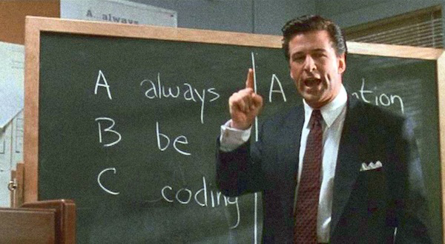
ABC
Credits to https://medium.com/@davidbyttow/abc-always-be-coding-d5f8051afce2
Notes:
lots of practice

Slide 30
I want to be a better Computer Scientist
Be passionate, stubborn, humble, and read-read-read!
Also, think out of the box :)
10k-hrs rule - http://norvig.com/21-days.html

Slide 31
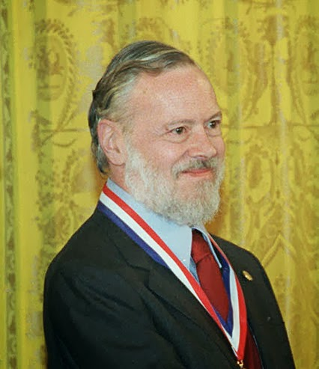
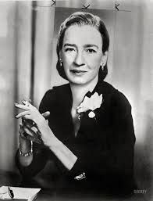
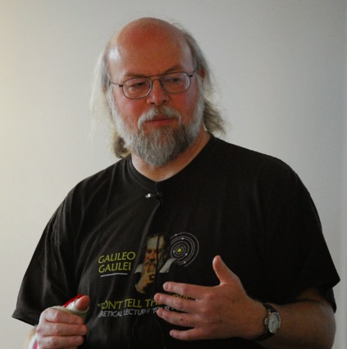
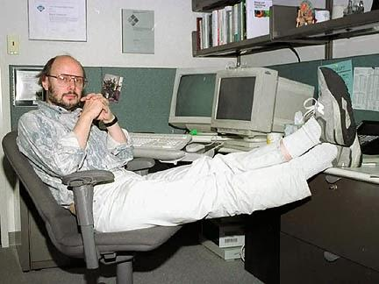
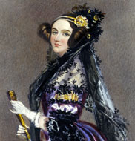
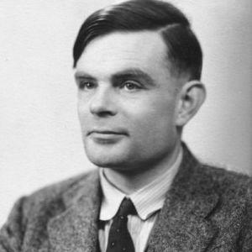

Slide 32
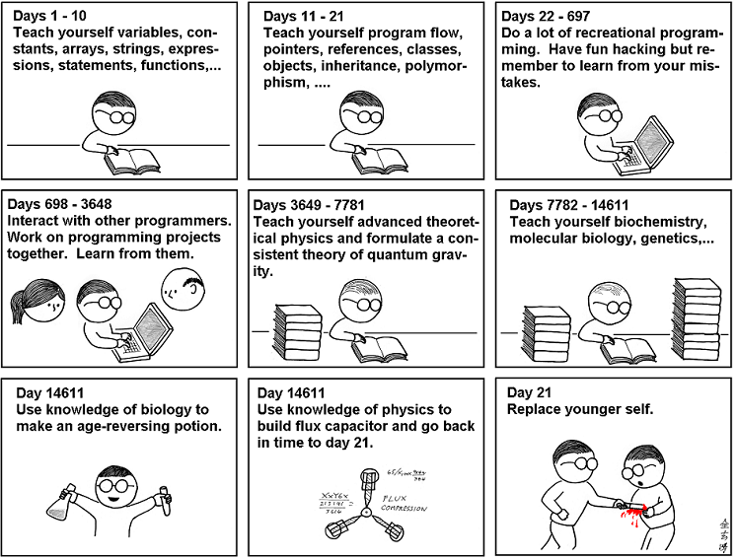
http://mishadoff.com/blog/programming-digest-2/

Slide 33
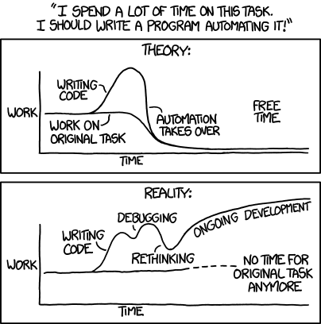
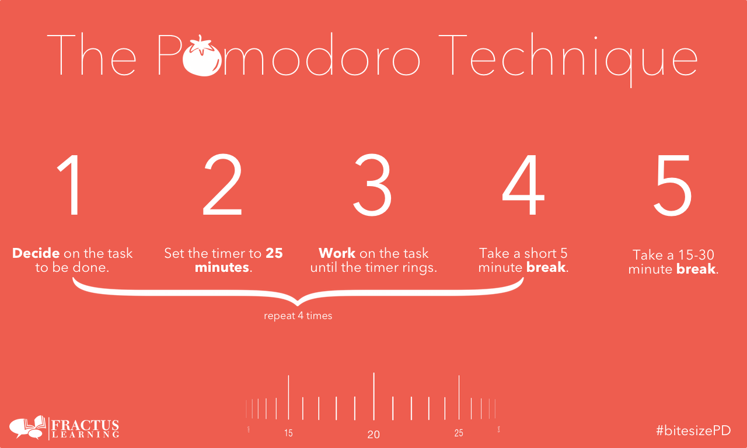
https://xkcd.com/1319/
http://pomodorotechnique.com/

Slide 34
Time management - Summary
Different philosophies, different approaches, different techniques.
All have:
Have breaks while working
Have a life too
Do not be afraid of getting it wrong
Later Equals Never
http://robertgreiner.com/2011/07/later-equals-never/

Slide 35
Process Models
5 Minutes in Software Engineering techniques to go from requirements to code to product.
Minimal Model (X)
Waterfall (w/wo feedback) (X)
Scrum (3rd year project) (V)
Pair Programming (1st, 2nd year group projects) (?)
Etc.
Not all of these are good

Slide 36
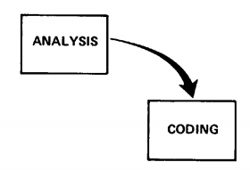
Minimal Software Process Model
Winston W. Royce,
Managing the Development of Large Software Systems

Slide 37
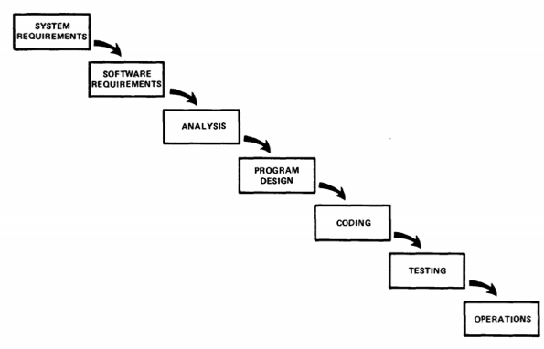
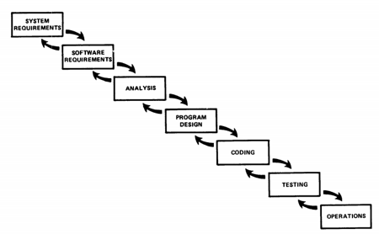
The “Waterfall” Model - w/wo feedback
Paper http://www.cs.umd.edu/class/spring2003/cmsc838p/Process/waterfall.pdf

Slide 38
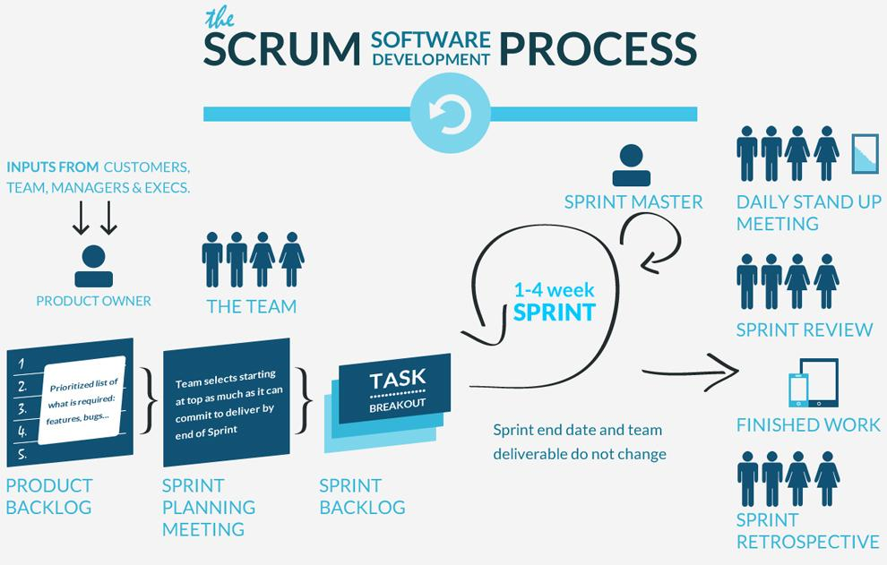
Source https://www.ics.ie/news/view/1653
Notes:
http://techiejs.com/Blog/Post/Working-Agile-like-with-SCRUM-and-Extreme-Programming

Slide 39
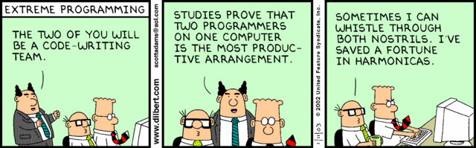
Pair Programming
Source: http://techiejs.com/Blog/Post/Working-Agile-like-with-SCRUM-and-Extreme-Programming

Slide 40
Summary about SE Processes
Do you need to know all this stuff to be successful in my coursework?
NO
Be agile
Listen to your client
Use/Test your code
Do not be afraid of changing your design/code
Tradeoff between perfection and productivity

Slide 41


Slide 42
5-10 minutes of Common Mistakes in Java/C

Slide 43
Common Mistakes (Java) I
public class StaticDemo { public String my_member_variable = "somedata";
public static void main (String args[]) { // Access a non-static member from static method System.out.println ("This generates a compiler error" + my_member_variable ); } }

Slide 44
Common Mistakes (Java) II
public class MyWindowListener extends WindowAdapter { // This should be WindowClosed public void WindowClose(WindowEvent e) { // Exit when user closes window System.exit(0); } });

Slide 45
Common Mistakes (Java) IV
{ Connection dbConnection = initConnect(); PreparedStatement query = c.preparedStatement(...); … ResultSet resultSet = query.execute(); … ???
}

Slide 46
Common Mistakes (Java) IV
{ Connection dbConnection = initConnect(); PreparedStatement query = c.preparedStatement(...); … ResultSet resultSet = query.execute(); … resultSet.close(); query.close(); dbConnection.close();
}

Slide 47
Common Mistakes (Java 7+) IV - AutoClosable
try ( Connection dbConnection = initConnect(); PreparedStatement query = c.preparedStatement(...); ) { // code resultSet = query.execute(); // code } catch (...) {} finally { if (resultSet != null) resultSet.close();
}

Slide 48
Common Mistakes (Java) V
= instead of ==
== instead of equals
by value (primitive) vs by reference (objects)

Slide 49
Common Mistakes (C/Java) I
int x = 2; switch(x) { case 2: printf("Two\n"); case 3: printf("Three\n"); }

Slide 50
Common Mistakes (C) II
int a[10]; // from 0 to 9, not to 10 (same in Java)
char ch = 'A'; /* correct */ char ch = "A"; /* error */
const char * st = "A"; /* correct */ const char * st = 'A'; /* error */
Notes:
http://www.drpaulcarter.com/cs/common-c-errors.php

Slide 51
Common Mistakes (C) III
char st1[] = "abc"; char st2[] = "abc"; if ( st1 == st2 ) printf("Yes"); else printf("No");

Slide 52
Common Mistakes (C) III
if ( strcmp(st1,st2) == 0 ) printf("Yes"); else printf("No");

Slide 53
What the experts say
“Don't judge people based on code. You don't know under what conditions the code was written, there was likely an idiot manager forcing the developer to compromise.”
(A. O’Lenskie - Adobe)
“I think choosing technology/platforms wisely is quite a big one. Also timing is important.”
(N. Moore - Adobe)
“I think for early students, the most important thing is to try to make their program compile and run (so they can test it) as early as possible, then keep iterating by adding small features and retesting.” (C. Jefferson - St Andrews)

Slide 54
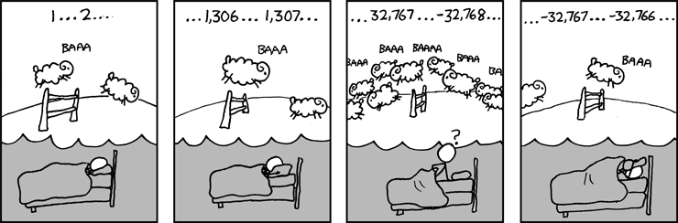
Know the basics
Primitives
Strings
OOP
Streams
Data Structures
Exceptions
Etc
https://xkcd.com/571/
Notes:
example - use smart pointers in C++

Slide 55
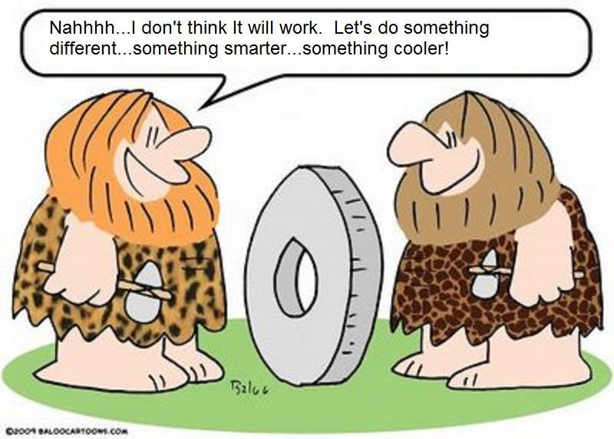
The wheel problem
“I reinvented the wheel last week. I sat down and deliberately coded something that I knew already existed, and had probably also been done by many many other people. In conventional programming terms, I wasted my time. But it was worthwhile, and what's more I would recommend almost any serious programmer do precisely the same thing.”
James Hart
Who's James Hart? Just another programmer.
https://www.linkedin.com/pulse/stop-reinventing-wheel-philip-holt

Slide 56
Verification & Validation
Verification:
are we building the system right (according to its specification)?
Validation:
are we building the right system (the one the users require)?

Slide 57

Break your own code!
Be active and become the hacker of your own product.
There is not a guide book or some other type of Holy Grail. The more you program, the more you challenge yourself, the better you get to break code.
Note: breaking others’ code is illegal
TopCoder challenge’s steps:
Solve
Break
Test
https://www.topcoder.com/

Slide 58
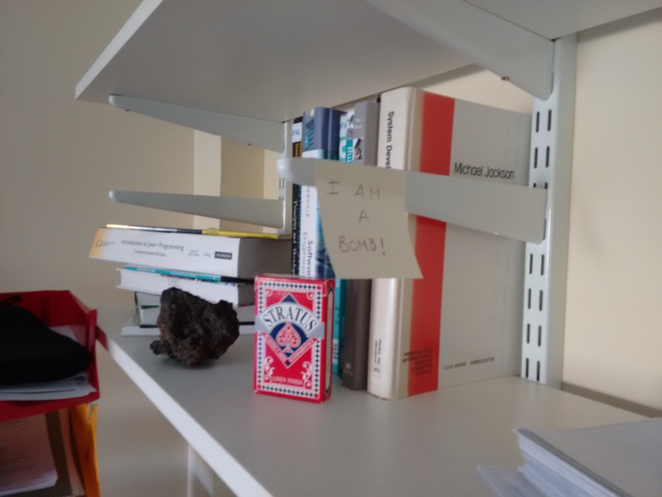
Notes:
Bomb Analogy - if you can get in, put a post it, then there is a security issues with your software.

Slide 59
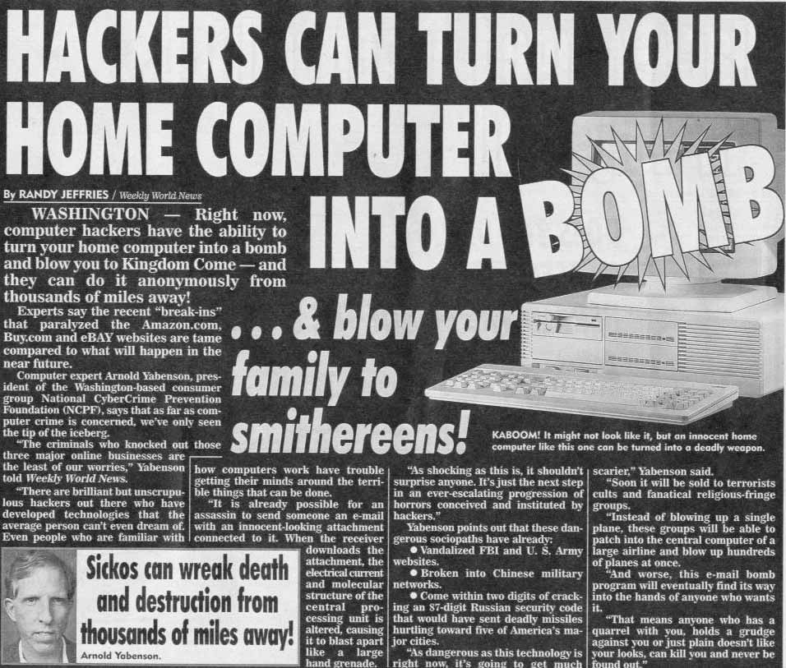
Know how to use internet!
This is what I got when looking for:
“Bomb in a shelf security example”
https://www.reddit.com/r/pics/comments/klr85/hackers_can_turn_your_home_computer_into_a_bomb/

Slide 60
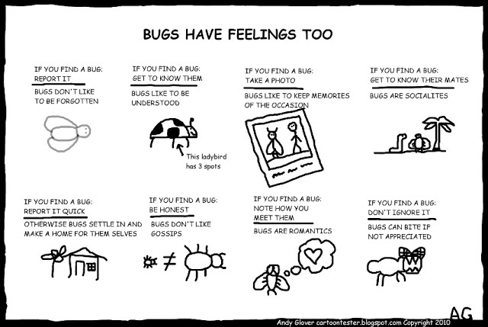
Software Testing
http://cartoontester.blogspot.co.uk/

Slide 61
What to test?
Inputs
Edge-cases
Conditionals
Manual vs Automated
Make it so simple that there are obviously no bugs, or so complex that there are no obvious bugs.
[ Tony Hoare - The Emperor’s Old Clothes (1981) ]

Slide 62
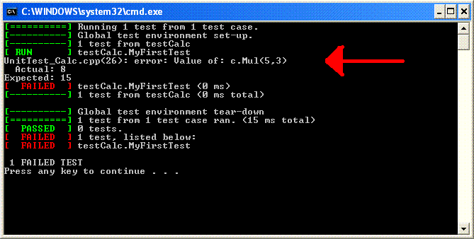
What to test?
Inputs
Edge-cases
Conditionals
Manual vs Automated
JUnit, TestNG, mockito
gtest, gmock
Karma, Protractor
etc..

Slide 63
F.I.R.S.T.
Fast
so you can run them often
Independent
from each other
Repeatable
in any envirnment
Self-validating
either pass or fail
Timely
write them beforehand
Source: http://agileinaflash.blogspot.de/2009/02/first.html
Notes:
cite this.

Slide 64
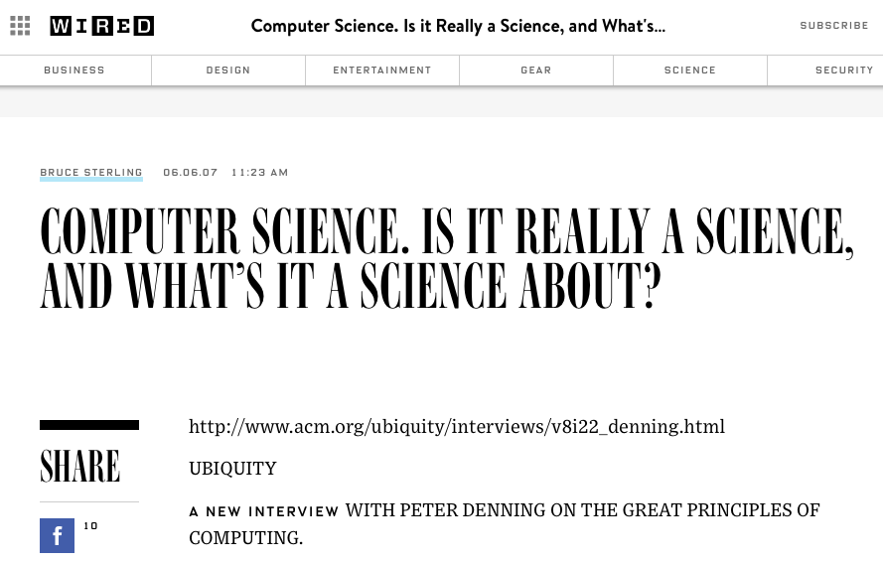
Computer Science
Make sure your code is
Clear
Can take different inputs
Repeatable
Produces clear outputs
Runs in the lab machines at least
Scientific!
http://www.wired.com/2007/06/computer_scienc/

Slide 65
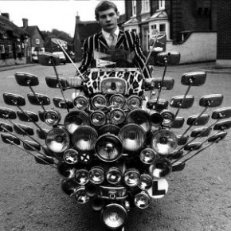
Style Matters

Slide 66
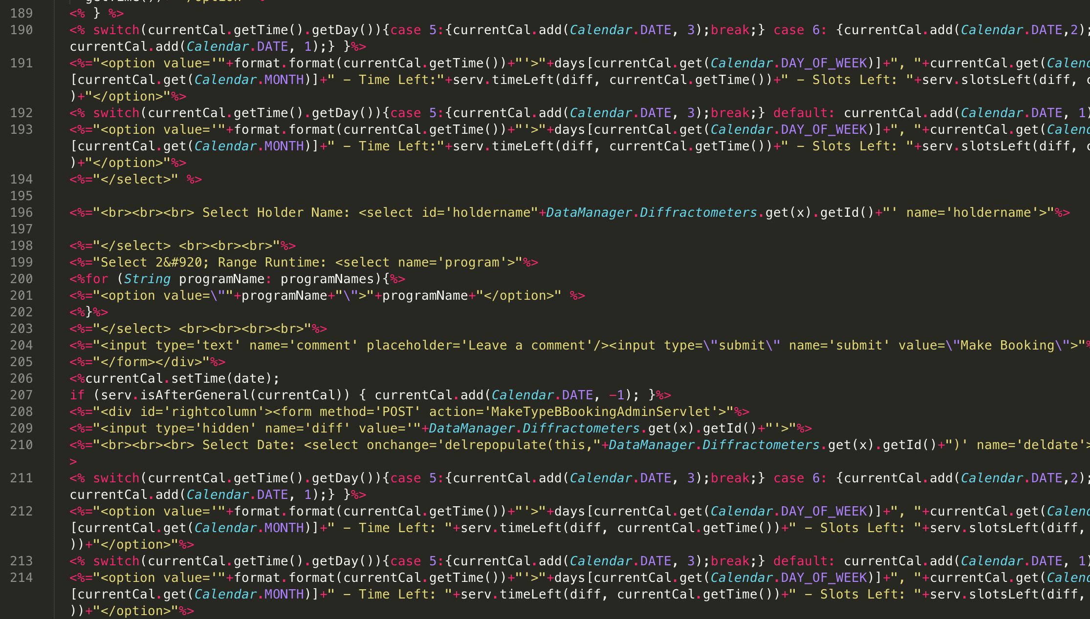

Slide 67
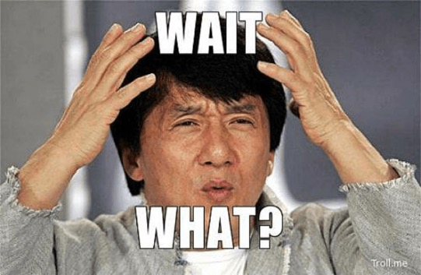
Wait… what?
private int parentClassType() { if (1 == 2) { return PARENT_MY_SCHEDULE_ACTIVITY; } else { return PARENT_MY_SCHEDULE_ACTIVITY; } }
Other examples here: https://www.reddit.com/r/badcode

Slide 68
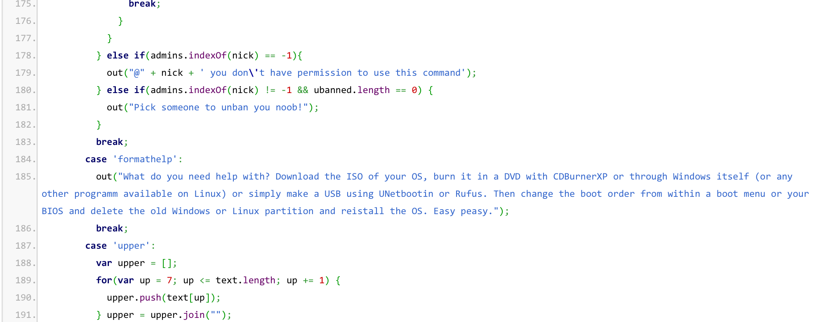
This was for a chatbot
https://www.reddit.com/r/badcode/comments/3ko55o/someone_tried_to_make_a_chatbot_for_a_programming/

Slide 69
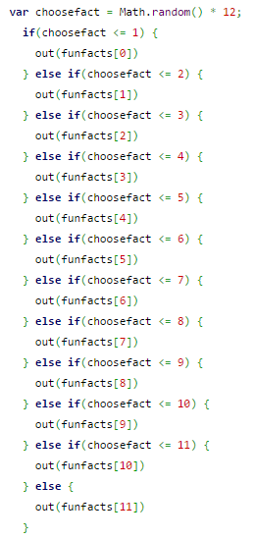
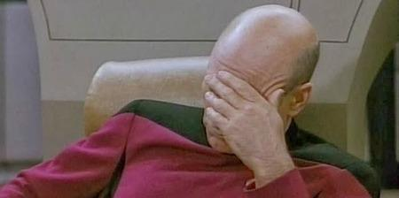
Rounding numbers
https://www.reddit.com/r/badcode/comments/3j37iy/if_you_can_not_round_numbers/

Slide 70
Obfuscated Code
float s=1944,x[5],y[5],z[5],r[5],j,h,a,b,d,e;int i=33,c,l,f=1;int g(){return f=
(f*6478+1)%65346;}m(){x[i]=g()-l;y[i]=(g()-l)/4;r[i]=g()>>4;}main(){char t[1948
]=" `MYmtw%FFlj%Jqig~%`jqig~Etsqnsj3stb",*p=t+3,*k="3tjlq9TX";l=s*20;while(i<s)
p[i++]='\n'+5;for(i=0;i<5;i++)z[i]=(i?z[i-1]:0)+l/3+!m();while(1){for(c=33;c<s;
c++){c+=!((c+1)%81);j=c/s-.5;h=c%81/40.0-1;p[c]=37;for(i=4;i+1;i--)if((b=(a=h*x
[i]+j*y[i]+z[i])*a-(d=1+j*j+h*h)*(-r[i]*r[i]+x[i]*x[i]+y[i]*y[i]+z[i]*z[i]))>0)
{for(e=b;e*e>b*1.01||e*e<b*.99;e-=.5*(e*e-b)/e);p[c]=k[(int)(8*e/d/r[i])];}}for
(i=4;i+1;z[i]-=s/2,i--)z[i]=z[i]<0?l*2+!m():z[i];while(i<s)putchar(t[i++]-5);}}
Source http://www.ioccc.org/years.html#1996_eldby
Notes:
This program shows flying spheres. The program eats CPU on lesser equipt systems. The program will run until termination. Terminal must be vt100 or better with 80 columns and 24 rows or more.

Slide 71
Good code example
public static void main(String[] args) { System.out.println("Hello, World"); }

Slide 72
Checking Style Tools
There are many of them.
Java - PMD, FindBugs, JTest, Checkstyle
C - QA-C, CodeSonar
C++ - PC-Lint, C++Test, Coverity
C# - FxCop, StyleCop, TICS
Python - pylint, pep-8, pychecker
etc ...
Many False-Positives!
Many options. There is not a right one → best check style tool is you!
Notes:
https://en.wikipedia.org/wiki/List_of_tools_for_static_code_analysis
http://www.tiobe.com/index.php/content/paperinfo/HowToUseCodingStandards.html
Shyam talks 5-10 mins

Slide 73
Watch-Out for warnings
C/C++
-Werror (make all warnings into errors); -Wall; -Wextra
Windows - /Wn; /WX; /Wall; etc
Look after your compiler
Java
-Xlint (enables all recommended warnings)
http://docs.oracle.com/javase/7/docs/technotes/tools/solaris/javac.html
Know your language

Slide 74
Indentation
Many styles → https://en.wikipedia.org/wiki/Indent_style
There is not a right one
Be reasonable and consistent

Slide 75
Formatting
Vertical formatting
keep things to a length that people will want to read.
separate thoughts by empty lines, keep related thoughts close
Place variables close to where they are used.
Instance variables should be at the top of a class.
Prefer short lines over long ones, avoid lines of more than 80 characters, never use more than, say, 100.
Use IDE tools to keep things tidy and aligned with a consistent code style (week 7 - 1st year)

Slide 76
Formatting
Space vs Tabs

Slide 77
Formatting - Example
private int x; // this is fine private Color color; // this too private int x; // permitted, but future edits private int y;
private Color color; // may leave it unaligned private int y;
Google Java Style guide: https://google.github.io/styleguide/javaguide.html#s4.6.3-horizontal-alignment

Slide 78
Comments (I)
/** * For the brave souls who get this far: You are the chosen ones, * the valiant knights of programming who toil away, without rest, * fixing our most awful code. To you, true saviors, kings of men, * I say this: never gonna give you up, never gonna let you down, * never gonna run around and desert you. Never gonna make you cry, * never gonna say goodbye. Never gonna tell a lie and hurt you. */
Credits to the SO Community - http://stackoverflow.com/questions/184618/what-is-the-best-comment-in-source-code-you-have-ever-encountered

Slide 79
Comments (II)
// // Dear maintainer: // // Once you are done trying to 'optimize' this routine, // and have realized what a terrible mistake that was, // please increment the following counter as a warning // to the next guy: // // total_hours_wasted_here = 42 //
Credits to the SO Community - http://stackoverflow.com/questions/184618/what-is-the-best-comment-in-source-code-you-have-ever-encountered

Slide 80
Comments (III)
//When I wrote this, only God and I understood what I was doing //Now, God only knows
Credits to the SO Community - http://stackoverflow.com/questions/184618/what-is-the-best-comment-in-source-code-you-have-ever-encountered

Slide 81
Comments (IV)
return 1; # returns 1
Credits to the SO Community - http://stackoverflow.com/questions/184618/what-is-the-best-comment-in-source-code-you-have-ever-encountered

Slide 82
Comments (V)
/** * Always returns true. */ public boolean isAvailable() { return false; }
Credits to the SO Community - http://stackoverflow.com/questions/184618/what-is-the-best-comment-in-source-code-you-have-ever-encountered

Slide 83
Comments (VI)
long long ago; /* in a galaxy far far away */
Credits to the SO Community - http://stackoverflow.com/questions/184618/what-is-the-best-comment-in-source-code-you-have-ever-encountered

Slide 84
Comments (VII)
// I can't divide with zero, so I have to divide with something very similar result = number / 0.00000000000001;
Credits to the SO Community - http://stackoverflow.com/questions/184618/what-is-the-best-comment-in-source-code-you-have-ever-encountered

Slide 85
Lessons learned
Funny comments waste time - wasted time to write, wasted time to read, wasted time to show to your colleagues the funny remark that is (almost always) merely puzzling and so on.
If funny comments were actually funny it would change my mind. But once you encourage jokes, do you encourage swearing or insults or maliciousness?
Credits to user amelvin - http://programmers.stackexchange.com/questions/60699/is-funny-commenting-a-bad-practice-or-not

Slide 86
Other bad examples
fred.penColor(Color.blue);
// the colour of the pen has been set to blue
tom.bodyColor(Color.red);
// the turtle's body colour has been changed to blue
//imports Turtle Donald into Drawing Window Object
DrawingWindow.add(Martin);

Slide 87
Good Comments
Legal comments (author, copyright, license etc.);
IDEs might collapse lengthy legal comments
Informative Comments
JavaDoc comments in public APIs
Expressing intention
Clarifications
Explaining code that cannot be changed and is therefore unclear
e.g., when using a standard library
Warning of consequences
TODO/FIXME comments
Highlighting something as important that is not obvious

Slide 88
Good Comments - Example I
// format matcher kk:mm:ss EEE, MMM dd, yyyy Pattern timeMatcher = Pattern.compile(“\\d*:\\d*:\d* \\w*, \\w* \\d*, \\d*”);
Credits to CleanCode

Slide 89
Good Comments - Example II
// Every multiple in the array has a prime factor that // is less than or equal to the root of the array size, // so we don’t have to cross out multiples of numbers // larger than that root double iterationLimit = Math.sqrt(crossedOut.length); return (int) iterationLimit;
Credits to CleanCode

Slide 90
Summary
Don’t comment bad code, rewrite it
(Kernighan, Plaugher)
Be informative
Be clear
Be consistent
Avoid comments if you can communicate intention through code
Do not leave commented code around if not needed

Slide 91
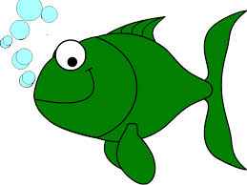

Slide 92
Naming Practices
Names are everywhere in software. And software must be readable by us and others.
Intention-revealing names
Avoid disinformation
Pronouncable and searchable names

Slide 93
Use Intention-Revealing names
the names of variables, methods, classes etc. should tell what these things are about.
Bad
d, h, t, es, p
list, array, space
getThem(), get()
users, active
Good
distance, height, time
board, cell
getWeight(), getMachine()
numberOfUsers, numberOfActiveUsers

Slide 94
Avoid Disinformation
do not refer to something as a List unless it actually is a List.
Bad
hp, aix, sco (UNIX)
accountList (for array)
XYZAccountControllerList vs XYZAccountHandlerList
l (vs 1)
O (vs 0)
O1, Ol, 0l, 01
Good
hypotenuse, axes, etc
accountGroups, accounts
accountController vs accountHandler

Slide 95
Pronouncable and Searchable names
Humans are good at words. And words are pronouncable.
Bad
DtaRcrd102
genymdhms
modymdhms
srchbl
7, 15
t
Good
Customer
generationTimestamp
modificationTimestamp
searchable
MAX_NUMBER_MACHINES, TASKS_THRESHOLD
tasks

Slide 96
Others
Classes should have noun or noun-phrase names rather than verb names
avoid empty words such as Info, Data, Manager, Processor in a class name
Ex: Customer, WikiPage, Account, HashIntegrationTest, ImmutableList, etc
Methods should have a verb name
Accessors, mutators, and predicates should be named for their value and preﬁxed with get, set, and is
Ex: sendMessage(), stop(), receiveMessage(), sendAck(), getUsername(), etc
“Don’t be cute”
Ex: kill(), abort(), deleteItems() instead of whack(), eatMyShorts(), HolyHandGranade()
Avoid single-letter variable names and similar things that have nothing to do with the problem domain.
Check https://studres.cs.st-andrews.ac.uk/CS5031/Lectures/week04/cleancode.html (based on Clean Code book)

Slide 97
Others
Classes → use singular names
Fine to have one-single-letter variables for counter variables
for(int i = 0; i < CONSTANT; i++)
Some counter variable may be better “extended”
for(int cell=0; cell < board[0].length; cell+)
Check https://studres.cs.st-andrews.ac.uk/CS5031/Lectures/week04/cleancode.html (based on Clean Code book)

Slide 98
Summary
Be consistent
Be reasonable
Use meaningful names
Use readable names
Use searchable names
Use unambiguous names
Avoid colloquialism

Slide 99
Daniel Patterson, Sumdog
Think hard about how to name things. Names for objects and variables should describe what it is so that you don't need to refer back to its definition. It should describe what it is now, not what you want it to be eventually.
Single Responsibility Principle - objects and functions should do one thing. This means that you should be able to describe them without using 'and' / 'or'. Typically, it means functions shouldn't be more than 5 or 6 lines of code and shouldn't be indented more than once - so only one level of loops or conditional branching. This makes code much easier to read and reuse.

Slide 100
Methods/Functions
Make them small!
Do one thing, do it well, do it only!
Keep them about 15-20 lines long MAX!
Others suggest to have about 5-10 lines AND max 1 conditional statement
Do not mix levels of abstraction
Have no side effects
Either change state or return a value/object
Do not repeat yourself!

Slide 101
Methods/Functions - Example I
Bad
public boolean checkPwd(String[] usr, String[] pwd) { this.pwd = pwd; int[] valids = new int[10]; for(int i = 0; i < 10; i++) if (usr[i].pwd == pwd[i] && pwd[i].length() > 10) valids[i] = 1; int c = 0; for(int i = 0; i < 10; i++) if (valids[i]) c++; return c > 5 ? true : false; }

Slide 102
Methods/Functions - Example I
Better
public boolean checkPassword(String user, String password) { return (user.password.equals(password) && password.length() > MIN_PASSWORD_SIZE) }

Slide 103
Methods/Functions - Example I
Better ???
Ideally we should check the password validity before having set it
public boolean checkPassword(String user, String password) { return (user.password.equals(password) && password.length() > MIN_PASSWORD_SIZE) }

Slide 104
Methods/Functions - Example II
BAD
boolean val = true; boolean stop = false;
while (i < n && !stop) {
if (f(i)) {
val = false;
stop = true;
}
i++;
}
return val;

Slide 105
Methods/Functions - Example II
BETTER
while (i < n) {
if (f(i))
return false;
i++;
}
return true;

Slide 106
Methods/Functions - Example III
BAD
if (f1(i))
return true;
else if (f2(i))
return true;
else
return false;

Slide 107
Methods/Functions - Example III
BETTER
return f1(i) || f2(i);

Slide 108
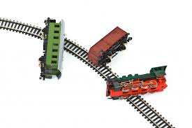
Trainwrecks
client.getAccounts().getAccount(1).applyPayment(300.00)

Slide 109
Trainwrecks
client.getAccounts().getAccount(1).applyPayment(300.00)
Better
AccountsGroup accounts = client.getAccounts();
Account accountToPay = accounts.getAccount(1);
accountToPay.applyPayment(300.0);

Slide 110
Magic Numbers
if (boom==3) explode(); else later(5000);

Slide 111
Magic Numbers
Better
private final static int TIMER_IS_OFF = 3; private final static int BOMB_WAITING_WINDOW = 5000; // in ms
if (boom==TIMER_IS_OFF) explode(); else later(BOMB_WAITING_WINDOW);

Slide 112
Static methods
Ask yourself:
“does it make sense to call this method, even if no Object has been constructed yet?”
convertMilesToKilometers()
setSpeed()
performFuelCleanup()
removeWheel()
makeString(int[])

Slide 113
Static methods - Tips
If you are writing utility classes and they are not supposed to be changed.
If the method is not using any instance variable.
If any operation is not dependent on instance creation.
If there is some code that can easily be shared by all the instance methods, extract that code into a static method.
If you are sure that the definition of the method will never be changed or overridden. As static methods can not be overridden.

Slide 114
Some advice from great experts
Lots of indentation (> 2 levels) is a bad smell - I would tend to extract the indented code to another private method. [ R. McMahon - Adobe ]

Slide 115
Some advice from great experts
I think for early students, the most important thing is to try to make their program compile and run (so they can test it) as early as possible, then keep iterating by adding small features and retesting. [...] Automating these tests will make things easier, but the important thing is to try not to write a few hundred lines of code, and only then try to make their code compile / run. [ C. Jefferson - St Andrews ]

Slide 116


Slide 117
The Simpler The Better
Patterns
OOP
Reusability
Refactoring
APIs

Slide 118
Software Design Patterns
Abstract Factory
MVC
Singleton
Observer
RAII - Resource Acquisition Is Initialisaiton
Proxy
Etc...
Notes:
https://en.wikipedia.org/wiki/Software_design_pattern

Slide 119
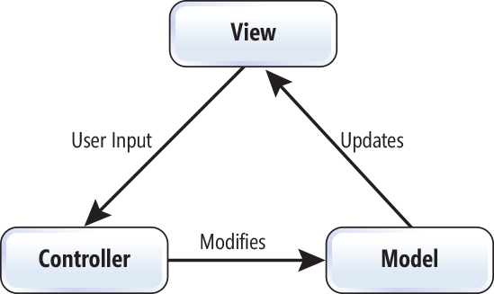
MVC - Model-View-Controller

Slide 120
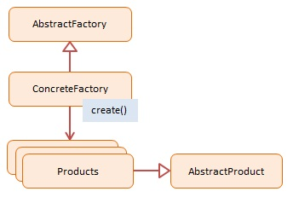
Abstract Factory

Slide 121
OOP
Inheritance
Composition
Generics
Interfaces
Abstraction
Polymorphism
Etc.
Notes:
http://stackoverflow.com/questions/3441090/what-is-composition-as-it-relates-to-object-oriented-design
https://en.wikipedia.org/wiki/Composition_over_inheritance

Slide 122
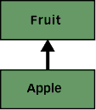
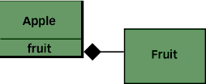
Example: Composition over Inheritance
B:
higher flexibility
better maintanability in the long term
changes do not propagate over the hierarchy
Go uses composition exclusively
C:
multiple methods’ implementations

Slide 123
What the experts suggest
Lean heavily on your tools.
Design systems in layers, so that they can be composed, layers can be swapped out, etc.
Try to keep your layers simple - the less they do the less likely you are to want/need to replace them at a later date.
[ Louis Morgan - Adobe ]

Slide 124
Reusability & Refactoring
Write code once if possible - if you find yourself writing the same code twice (or cutting and pasting some code) use a function instead.
[ Peter Brown - Adobe ]
Do not be afraid of changing and refactoring your code/design.

Slide 125
Interfaces/API
Be clear and consistent
Offer a variety of data formats (JSON, XML, etc) (API mostly)
Make the syntax intuitive and easy to understand
Thorough documentation
Use proper response codes
Don’t put instance data in interfaces (interfaces are for function declarations). [ Peter Brown - Adobe ]
Resources: http://stackoverflow.com/questions/6500468/recommendations-for-writing-an-api http://lcsd05.cs.tamu.edu/slides/keynote.pdf

Slide 126
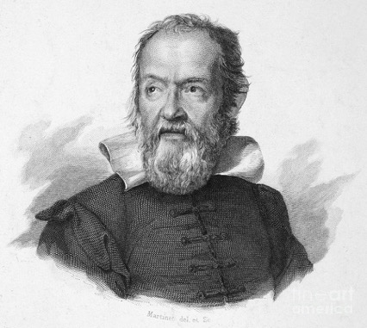
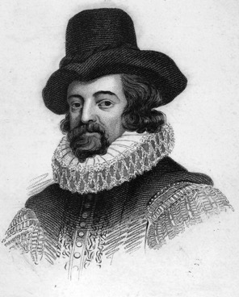
Reproducibility
CS → Computer Science
Do not hardcode the state of your program
Let the user input parameters
Let the user use different configurations
Avoid randomness wherever possible
Notes:
galileo galilei and francis bacon

Slide 127
Simplistic vs Engineered
Hot-topic
Too simplistic
Overly engineered
Find a tradeoff
HTTP Status Code example: https://blogs.dropbox.com/developers/2015/04/how-many-http-status-codes-should-your-api-use/

Slide 128
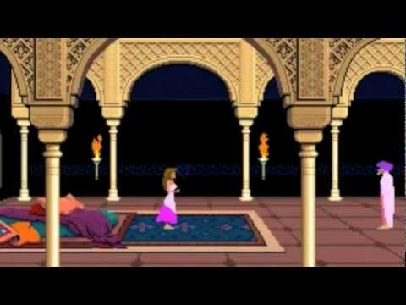
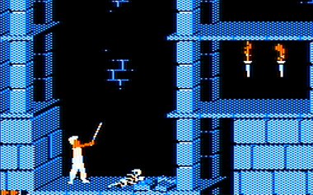
Prince of Persia
http://www.fabiensanglard.net/prince_of_persia/pop_boot2.php

Slide 129
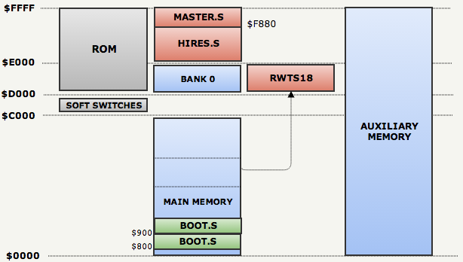
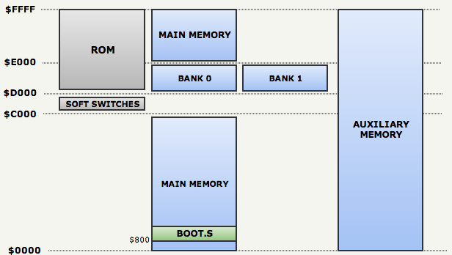
Prince of Persia
http://www.fabiensanglard.net/prince_of_persia/pop_boot2.php

Slide 130
Today your life is easier...or not?

Slide 131


















Today your life is easier...or not?

Slide 132
DO NOT DO THIS!
Lie in the comments. You don't have to actively lie, just fail to keep comments as up to date with the code.
Make sure that every method does a little bit more (or less) than its name suggests.
In the name of efficiency, use cut/paste/clone/modify. This works much faster than using many small reusable modules.
Try to pack as much as possible into a single line
Use very long variable names that differ from each other by only one character, or only in upper/lower case.
In naming functions, make heavy use of abstract words like it, everything, data, handle, stuff,..
Make as many of your variables as possible static.
Declare every method and variable public. After all, somebody, sometime might want to use it.
You get the pattern...
https://www.doc.ic.ac.uk/~susan/475/unmain.html
Notes:
make sure people understand that this is what they should not do

Slide 133
Good Academic Practice
TGAP - https://info.cs.st-andrews.ac.uk/student-handbook/academic/gap.html
CS Handbook - https://info.cs.st-andrews.ac.uk/student-handbook/academic/gap.html

Slide 134
Example - README
# Third party resources
The makefile is a modified version of the one provided by [Michael Safyan](https://sites.google.com/site/michaelsafyan/software-engineering/how-to-write-a-makefile)
Wavefront .obj loader (slightly modified version): [objLoader](http://www.kixor.net/dev/objloader/)
Image library (C/C++): [CImg](http://cimg.sourceforge.net/)
Images were all downloaded from internet. See appropriate text file in Data/ for specific links.

Slide 135
Example - In your code
/* * Profiling requires Google Perf Tools to be installed. * The tools are installed in my Mac, but not in the Lab Linux Machine I use. Therefore, profiling is always disabled for the latter machine. * http://goog-perftools.sourceforge.net/ */ #ifdef __APPLE__ #include <google/profiler.h> void Helper::START_PROFILING(std::string fileName) { if(PROFILER) ProfilerStart(fileName.c_str()); } void Helper::STOP_PROFILING() { if(PROFILER) ProfilerStop(); } #else void Helper::START_PROFILING(std::string fileName) {} void Helper::STOP_PROFILING() {} #endif

Slide 136
Example - In your code
// @see http://stackoverflow.com/questions/3585846/color-text-in-terminal-aplications-in-unix // e.g. printf("%sred\n", KRED);
#define KGRN "\x1B[32m" #define KNRM "\x1B[0m" #define KRED "\x1B[31m" #define KYEL "\x1B[33m" #define KBLU "\x1B[34m" #define KMAG "\x1B[35m" #define KCYN "\x1B[36m" #define KWHT "\x1B[37m"

Slide 137
Give credits to others
There is not a specific way of doing it as of today (15/10/2015)
Ask yourself “am I telling others that this code is from XYZ?”
If not, probably you are doing something wrong

Slide 138

The evolution of a SE (I yr)
Credits to Sean Hickey - https://medium.com/@webseanhickey/the-evolution-of-a-software-engineer-db854689243

Slide 139

The evolution of a SE (II yr)
Credits to Sean Hickey - https://medium.com/@webseanhickey/the-evolution-of-a-software-engineer-db854689243

Slide 140


The evolution of a SE (III yr)
Credits to Sean Hickey - https://medium.com/@webseanhickey/the-evolution-of-a-software-engineer-db854689243

Slide 141



The evolution of a SE (V yr)
Credits to Sean Hickey - https://medium.com/@webseanhickey/the-evolution-of-a-software-engineer-db854689243

Slide 142

The evolution of a SE (V yr) cont
Credits to Sean Hickey - https://medium.com/@webseanhickey/the-evolution-of-a-software-engineer-db854689243

Slide 143

The evolution of a SE (X yr)
Credits to Sean Hickey - https://medium.com/@webseanhickey/the-evolution-of-a-software-engineer-db854689243

Slide 144
So what?
Programming is hard

Slide 145

http://blogs.adobe.com/conversations/2015/10/at-max-content-velocity-meets-its-match.html?scid=social53499006&adbid=967586483284685&adbpl=fb&adbpr=341657335877606
Notes:
New research released by Adobe today paints a vivid picture of what we’re up against. It shows on average, U.S. consumers are using six devices and viewing 12 different sources of content. (So, I shouldn’t feel that bad carrying two phones, a laptop and a tablet while streaming Netflix on my TV.) Eighty-eight percent of consumers report they “multiscreen,” using nearly three devices simultaneously.

Slide 146


Slide 147
So what?
Programming is hard
Takes time
Talk about your design
Be stubborn
do not be afraid of changing/refactoring your code
Have some (a lot of) self-criticism
The simpler the better
Do not over-engineer if not needed
Check how others write code (i.e. GitHub)
remember that most people write bad code!

Slide 148
Thanks! Questions?
Experts’ Opinions - keeps updating - https://sic2.host.cs.st-andrews.ac.uk/aiq.html

Slide 149
Additional Slides - just for reference
School Handbook - https://info.cs.st-andrews.ac.uk/student-handbook/learning-teaching/programming-style.html

Slide 150
Other bad examples
public void addChange(int change) {
this.takings = takings + change;
}
could be
public void addChange(int change) {
takings += change;
}

Slide 151
Other bad examples
if (condition && condition2 && condition3 && condition4 && condition5 && condition6) {
}
could be
if (condition && condition2 &&
condition3 && condition4 &&
condition5 && condition6) {
}

Slide 152
Comments on static constants
Where you use an attribute as an absolute constant like MAX_ROWS it is
usual to declare it static (so that only one copy is kept) and final
(so that the compile knows it can't be overridden or changed. This
allows the compiler to optimize better.”

Slide 153
Done Manifesto
There are three states of being. Not knowing, action and completion.
Accept that everything is a draft. It helps to get it done.
There is no editing stage.
Pretending you know what you're doing is almost the same as knowing what you are doing, so just accept that you know what you're doing even if you don't and do it.
Banish procrastination. If you wait more than a week to get an idea done, abandon it.
The point of being done is not to finish but to get other things done.
Once you're done you can throw it away.
Laugh at perfection. It's boring and keeps you from being done.
People without dirty hands are wrong. Doing something makes you right.
Failure counts as done. So do mistakes.
Destruction is a variant of done.
If you have an idea and publish it on the internet, that counts as a ghost of done.
Done is the engine of more.
Credits: http://www.brepettis.com/blog/2009/3/3/the-cult-of-done-manifesto.html

Slide 154
Common erros in Java - Refs
http://www.open.ac.uk/StudentWeb/m874/!synterr.htm
https://docs.oracle.com/javase/tutorial/getStarted/problems/

